Slide 1
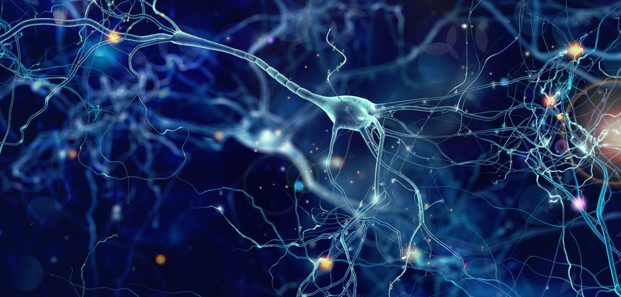
Advanced Workshop on Earthquake Fault Mechanics: Theory, Simulation and Observation (Trieste, 2019)
a gentle
into
introduction
MACHINE LEARNING

Slide 2
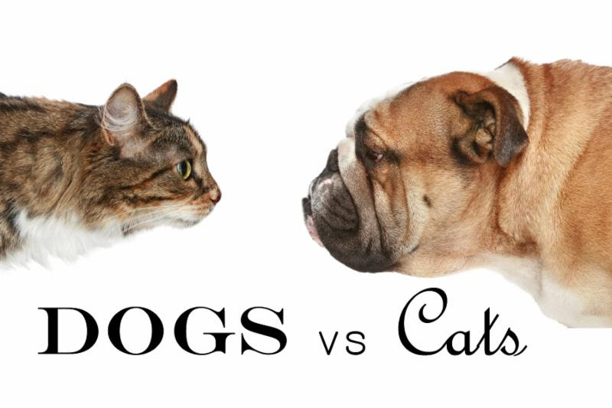

Slide 3


Slide 4


Slide 5


Slide 6
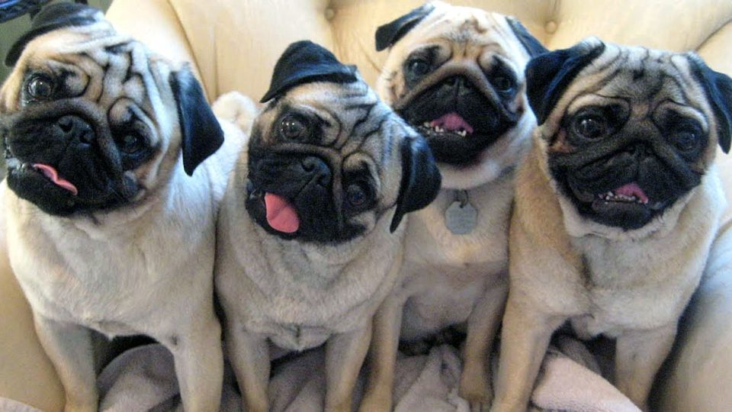

Slide 7


Slide 8
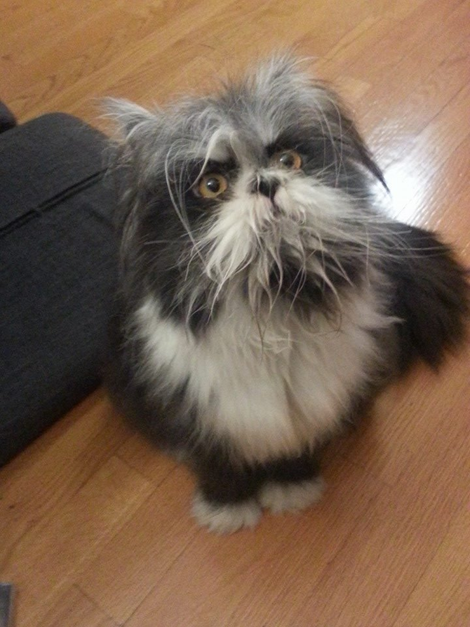

Slide 9
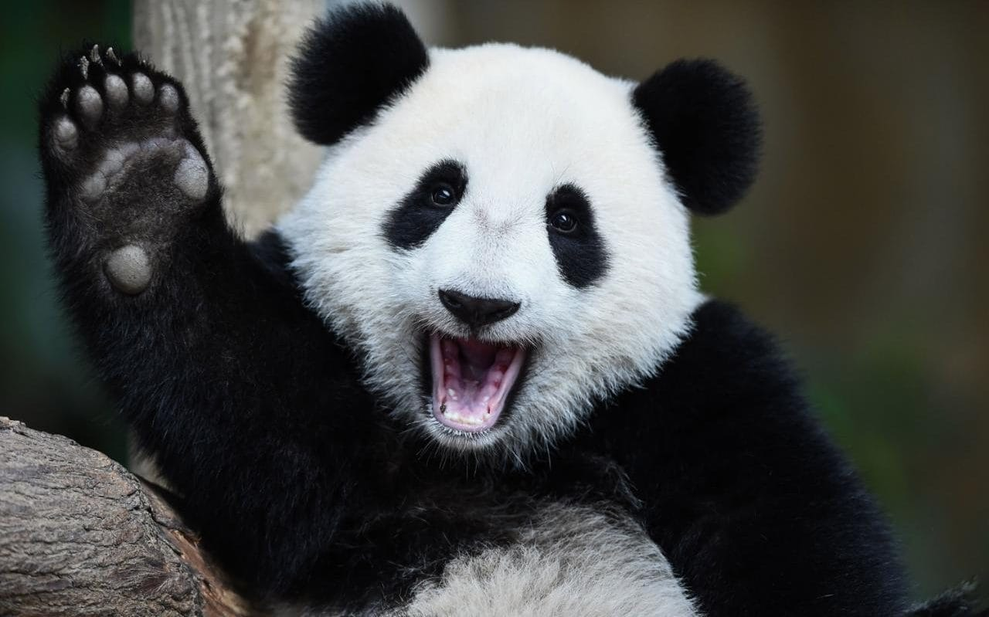

Slide 10
Distinguishing features?
Fur?
Number of eyes? Number of legs?
Whiskers?
Shape of ears?

Slide 11
Additional complications
Multiple objects

Slide 12
Additional complications
Multiple objects
Incomplete data

Slide 13
Additional complications
Multiple objects
Incomplete data
Conflicting information

Slide 14
Additional complications
Multiple objects
Incomplete data
Conflicting information
Uncategorised objects

Slide 15
Advantage of Machine Learning
In traditional approaches you have to be specific
In Machine Learning the specifics are learned

Slide 16
Today’s Menu
General overview of ML (history, examples, concepts) + basic hands-on tutorial
ML in Geosciences (examples & techniques) + advanced hands-on tutorial
Best practices and pitfalls + real-world exercise
Tomorrow: Random Forests + real-world exercise

Slide 17
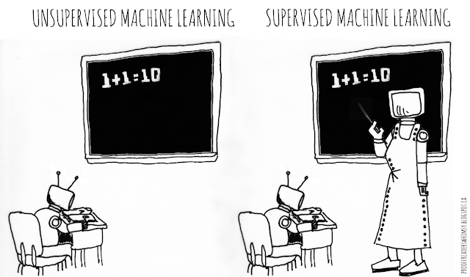
Part 1:
General overview of ML

Slide 18
AI vs. ML vs. DL
Artificial Intelligence (AI)
Machine Learning (ML)
Chess computers
Computer games
Robotics
Decision policies
Random Forests
Support Vector Machines
Deep Learning (DL)
Neural Networks with many
(up to hundreds) of “layers”

Slide 19
Machine Learning Is Not New!
1957: Perceptrons
1970 (Dark Age): Backpropagation
1982: Recurrent Neural Network
1989: Reinforcement Learning
Mid-late 90’s: “Silver Age”
1995: Random Forests, SVM
1997: IBM Deep Blue beats Kasparov
1997: LSTM
1998: CNN, handwriting analysis
2009: ImageNet, “Golden Age”
2010: Xavier initialisation
2015: TensorFlow
2016: AlphaGo
2019: Neural ODE
2014: DeepMind, GAN

Slide 20

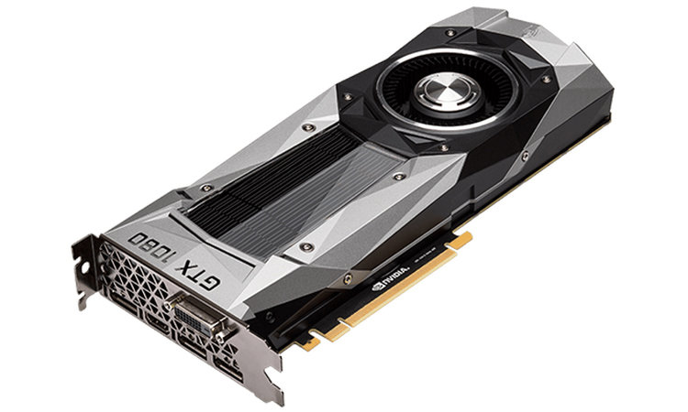
Machine Learning Is Not New!

Slide 21
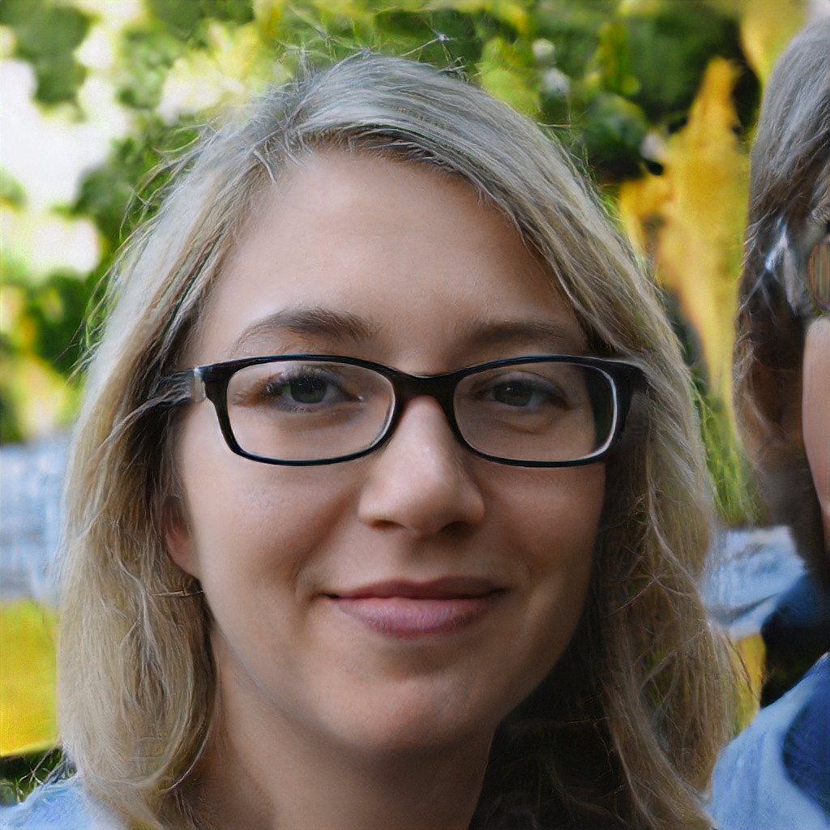
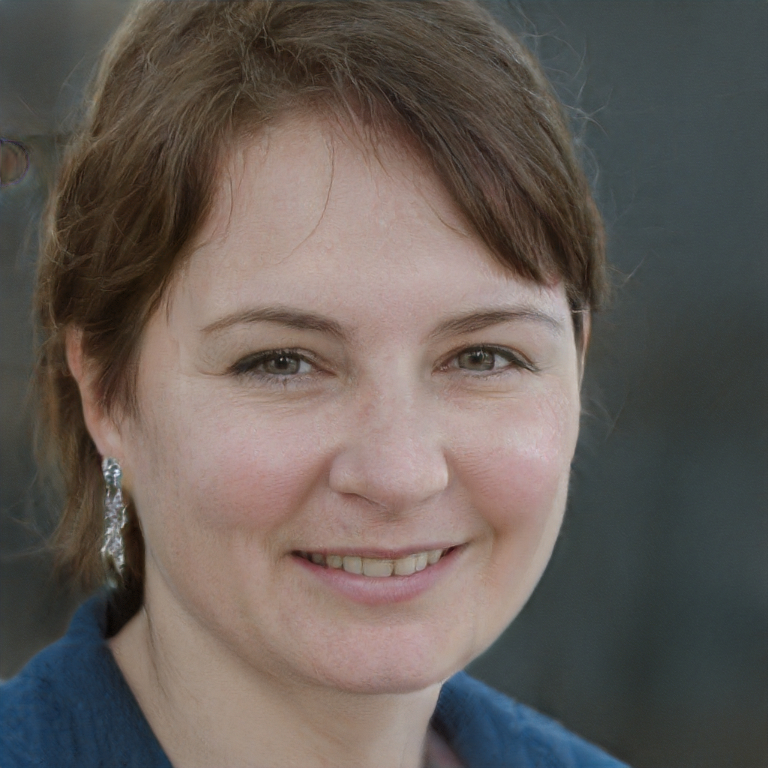
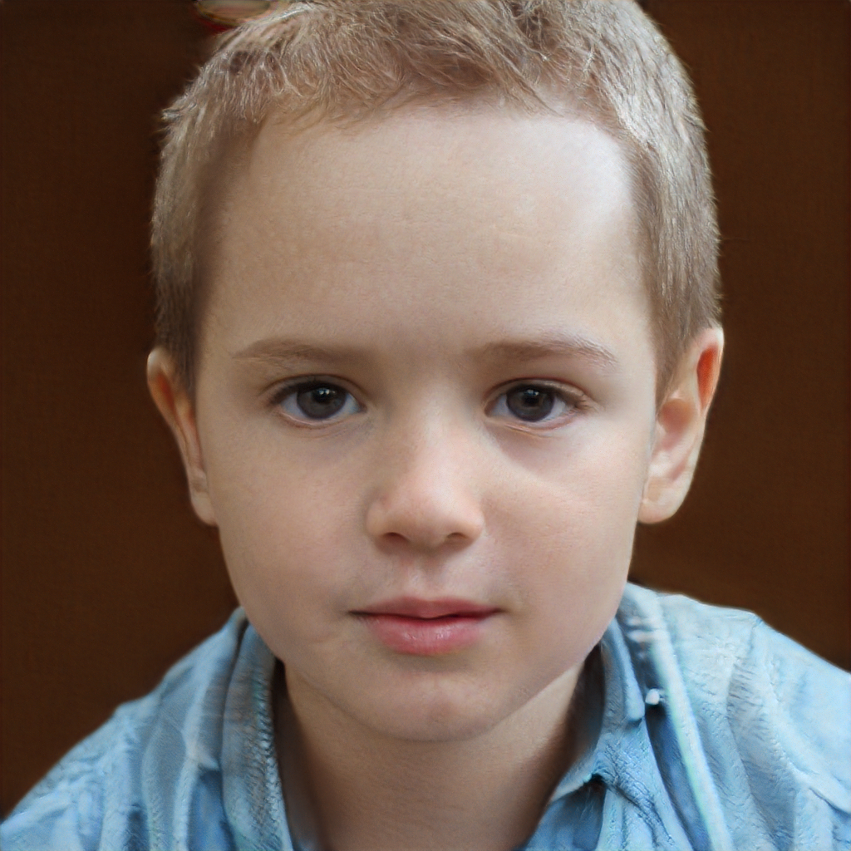
Examples of ML (Deep Learning)
ThisPersonDoesNotExist.com

Slide 22
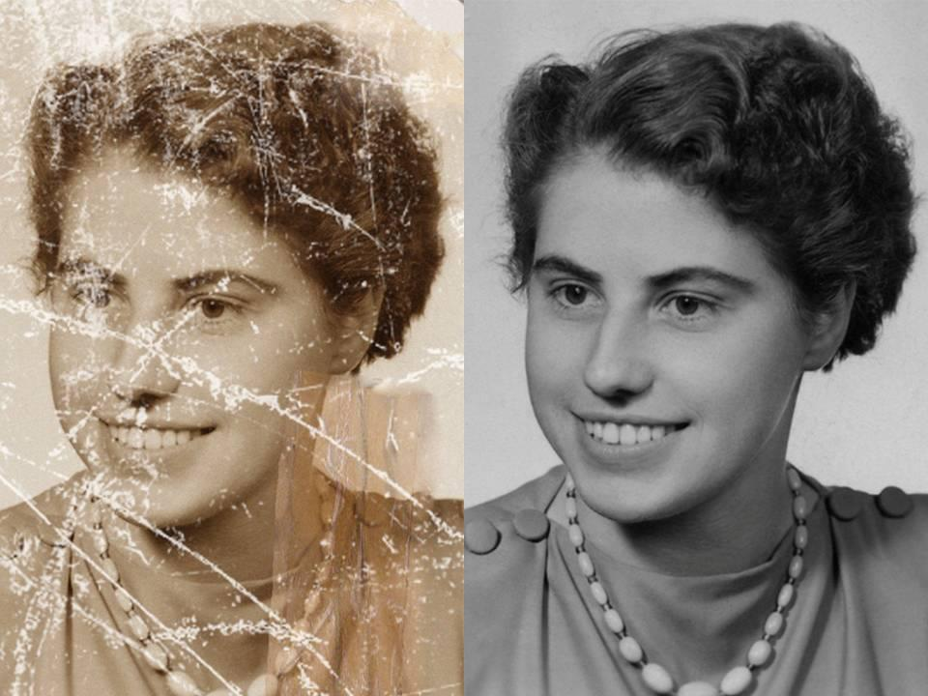
Examples of ML (Deep Learning)
https://github.com/WenchenLi/PhotoRestoration

Slide 23

Examples of ML (Deep Learning)

Slide 24
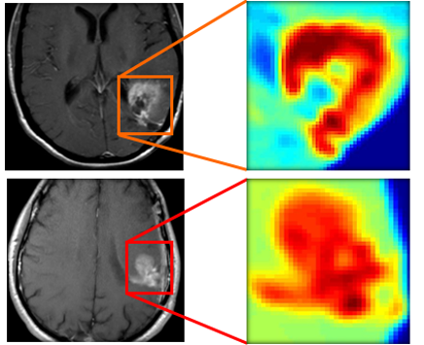
Examples of ML (Deep Learning)
Case Engineering

Slide 25
Basic Theory of Neural Networks

Slide 26
Intuition
Neural Nets find common patterns in data => generalisation
Learning from examples (supervised machine learning)
Apply generalised representation to new data
Analogy:
Students doing exercises in class
Learning general patterns and approach
Extrapolating during exam (same problem, different numbers)

Slide 27

It’s cold here… Am I near the North Pole?

Slide 28
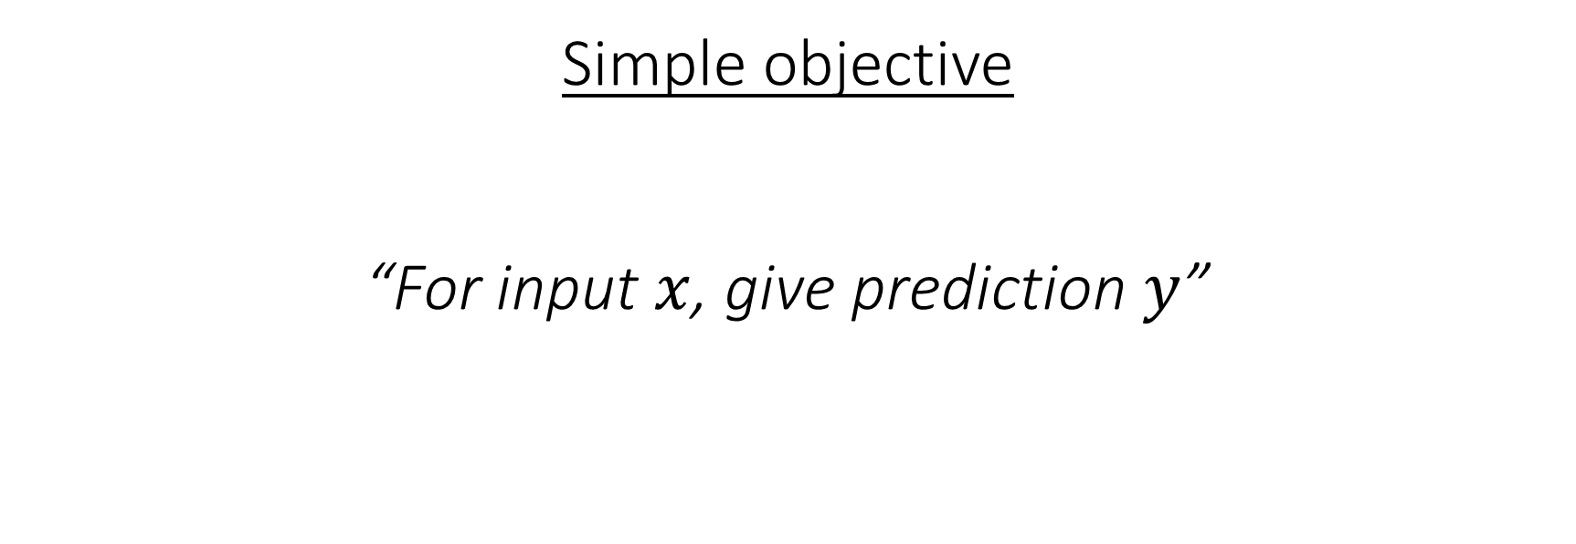
Basic Theory of Neural Networks
Simple objective
“For input $x$, give prediction $y$”
Input
Output

Slide 29
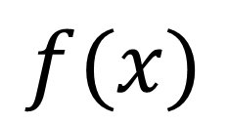
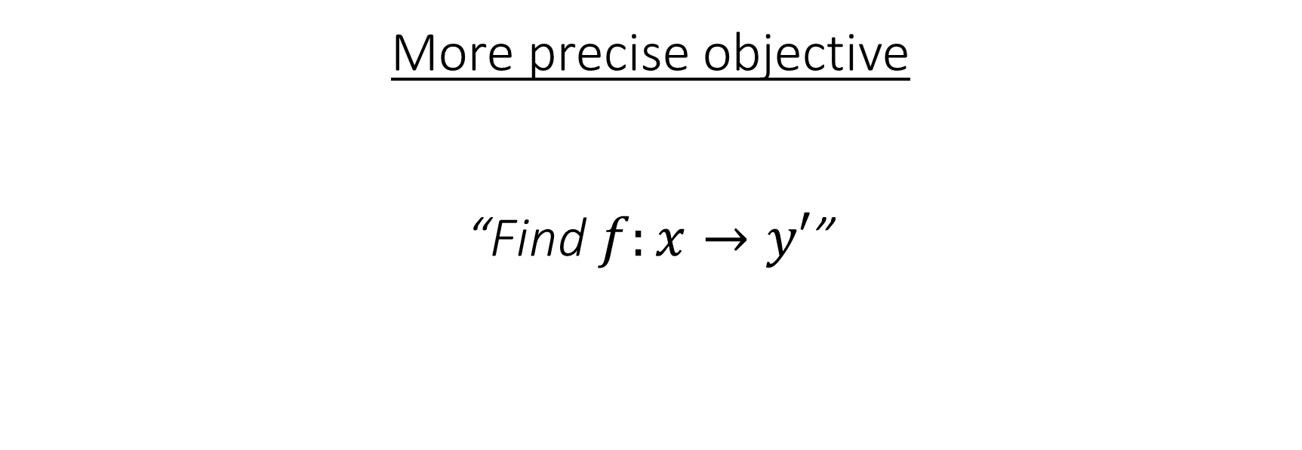
Basic Theory of Neural Networks
More precise objective
“Find $f:x→y′$”
Input
$$f(x)$$
Output

Slide 30
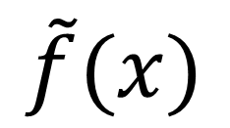
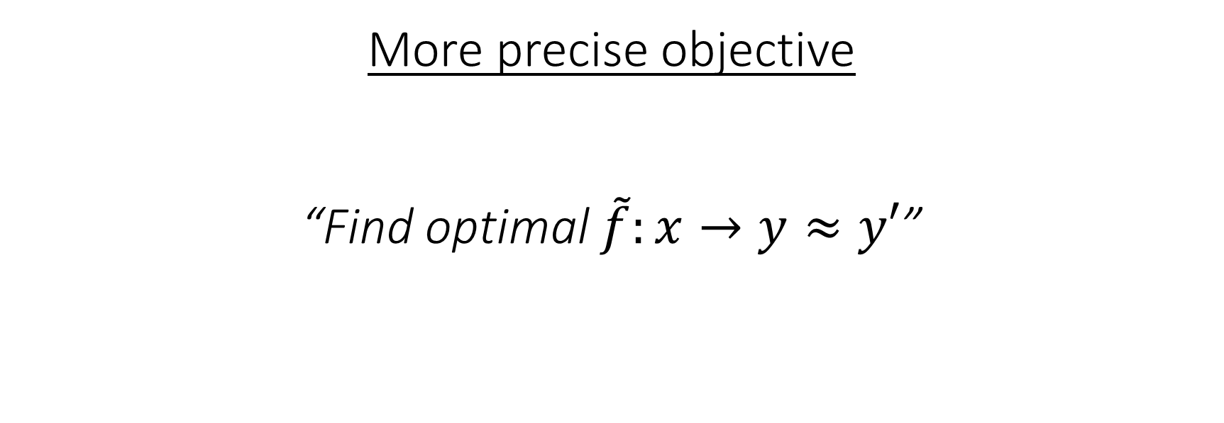
Basic Theory of Neural Networks
More precise objective
“Find optimal $\tilde{f}:x→y≈y′$”
Input
$$\tilde{f}(x)$$
Output

Slide 31
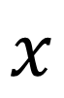
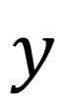
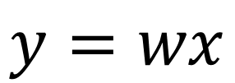
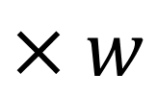
Single Neuron - Single Input
$$×w$$
$$x$$
$$y$$
$$y=wx$$

Slide 32
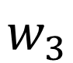
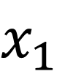
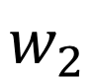
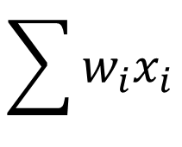
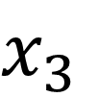
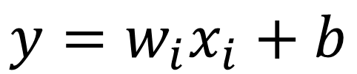
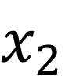
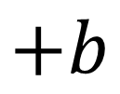
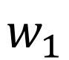
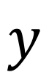
Single Neuron - Multi Input
$x_{1}$
$$w_{1}$$
$$w_{2}$$
$$+b$$
$x_{2}$
$$\sum{w_{i}x_{i}}$$
$$y$$
$$w_{3}$$
$x_{3}$
$$y=w_{i}x_{i}+b$$

Slide 33
Single Neuron - Multi Input
$x_{1}$
$$w_{1}$$
$$w_{2}$$
$$+b$$
$x_{2}$
$$\sum{w_{i}x_{i}}$$
$$y$$
$$w_{3}$$
$x_{3}$
“bias”
“weights”

Slide 34
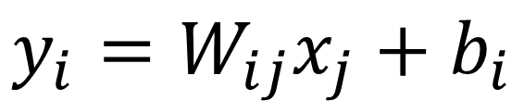
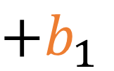
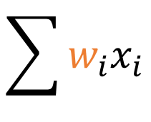

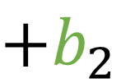
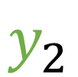

Single Layer of Neurons
$+b_{1}$
$x_{1}$
$$\sum{w_{i}x_{i}}$$
$$y_{1}$$
$x_{2}$
$+b_{2}$
$$\sum{w_{i}x_{i}}$$
$$y_{2}$$
$x_{3}$
$$y_{i}=W_{ij}x_{j}+b_{i}$$

Slide 35
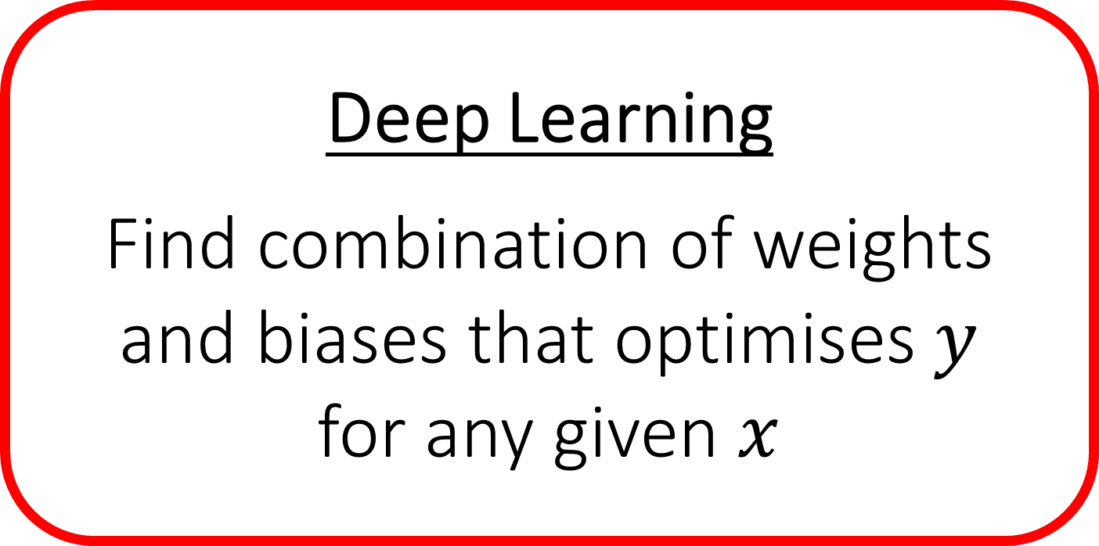
Single Layer of Neurons
$+b_{1}$
$x_{1}$
$$\sum{w_{i}x_{i}}$$
Deep Learning
Find combination of weights
and biases that optimises $y$
for any given $x$
$$y_{1}$$
$x_{2}$
$+b_{2}$
$$\sum{w_{i}x_{i}}$$
$$y_{2}$$
$x_{3}$
$$y_{i}=W_{ij}x_{j}+b_{i}$$

Slide 36

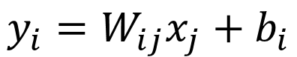
Single Layer - Example
Input Temperature Pressure pH Salinity Light-intensity ... | Neural Network | Prediction Latitude Longitude Depth
$$y_{i}=W_{ij}x_{j}+b_{i}$$

Slide 37
Single Layer - Example
Depth
Latitude
Pressure
Salinity

Slide 38
Single Layer - Example
Depth
Latitude
Pressure
Salinity

Slide 39
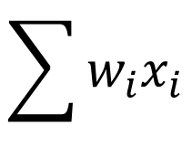
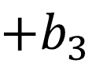
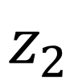
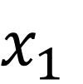
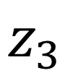
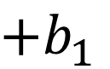
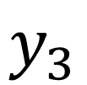
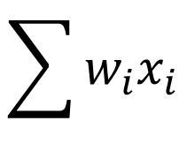
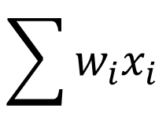
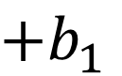
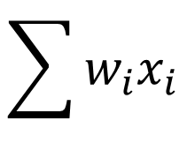
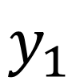









Multiple Layers of Neurons
$$\sum{w_{i}x_{i}}$$
$+b_{1}$
$$\sum{w_{i}x_{i}}$$
$+b_{1}$
$x_{1}$
$$y_{1}$$
$$z_{1}$$
$$\sum{w_{i}x_{i}}$$
$+b_{2}$
$$\sum{w_{i}x_{i}}$$
$+b_{2}$
$x_{2}$
$$y_{2}$$
$$z_{2}$$
$$\sum{w_{i}x_{i}}$$
$+b_{3}$
$$\sum{w_{i}x_{i}}$$
$+b_{3}$
$x_{3}$
$$y_{3}$$
$$z_{3}$$

Slide 40

Multiple Layers of Neurons
$$x^{(1)}=W^{(1)}x^{(0)}+b^{(1)}$$
$$x^{(2)}=W^{(2)}x^{(1)}+b^{(2)}$$
$$x^{(3)}=W^{(3)}x^{(2)}+b^{(3)}$$
$$⋮$$
$$x^{(n)}=W^{(n)}x^{(n−1)}+b^{(n)}$$

Slide 41

Quiz
$$x^{(n)}=W^{(n)}x^{(n−1)}+b^{(n)}$$
Multiple layers = better
Multiple layers = worse
Makes no difference

Slide 42

Multiple Layers of Neurons
$$x^{(2)}=W^{(2)}x^{(1)}+b^{(2)}$$
$$=W^{(2)}\left[W^{(1)}x^{(0)}+b^{(1)}\right]+b^{(2)}$$
$$=W^{∗}x^{(0)}+b^{∗}$$

Slide 43

Non-linearity
$$x^{(n)}=f\left(W^{(n)}x^{(n−1)}+b^{(n)}\right)$$
Non-linear function:
“Activation”

Slide 44






Activation Functions
$$x^{(n)}=f\left(W^{(n)}x^{(n−1)}+b^{(n)}\right)$$
$$x^{(n)}$$
$$x^{(n)}$$
$$W^{(n)}x^{(n−1)}+b^{(n)}$$
$$W^{(n)}x^{(n−1)}+b^{(n)}$$

Slide 45






Neural Network
Input $x^{(0)}$
$$x^{(1)}=f\left(W^{\left(1\right)}x^{\left(0\right)}+b^{(1)}\right)$$
We have a prediction $y$, and reality (“ground truth”) $y′$.
Performance of the neural net is given by a loss function: $ℒ(y,y^{′})$
Optimisation problem:
Find all $W^{(n)}$ and $b^{(n)}$ that minimise $ℒ(y,y^{′})$
$$x^{(2)}=f\left(W^{\left(2\right)}x^{\left(1\right)}+b^{(2)}\right)$$
$$x^{(3)}=f\left(W^{\left(3\right)}x^{\left(2\right)}+b^{(3)}\right)$$
Output $y$

Slide 46

Loss Functions
Mean-squared error:
$$ℒ\left(y,y^{′}\right)=\frac{1}{N}\sum_{i=1}^{N}{{\left(y_{i}−y_{i}^{′}\right)}^{2}}$$
Binary cross-entropy:
$$ℒ\left(y,y^{′}\right)=−\sum_{i=1}^{N}{y_{i}^{′}\log{y_{i}}+\left(1−y_{i}^{′}\right)\log{(1−y_{i})}}$$

Slide 47


Loss Landscape
Li et al. (2018), Visualizing the loss landscape of neural nets

Slide 48

Training = Optimisation
Create a training dataset with input $x$ and ground truth $y′$
Submarine example: $x=\left[T,P,pH,…\right]$, $y^{′}=\left[lat,lon,depth\right]$
Feed $x$ into the neural network, get prediction $y$
Calculate loss $ℒ(y,y^{′})$
Update all weights $W^{(n)}$ and biases $b^{(n)}$ to decrease $ℒ$
Repeat

Slide 49

Model Performance (classification)
Accuracy: how many predictions are correct?
$$A= \frac{correct predictions}{total predictions}=\frac{true positives+true negatives}{total predictions}$$

Slide 50

Model Performance (classification)
Precision: how reliable are the predictions?
$$P=\frac{true positives}{true positives+false positives}$$
How often is the model fooled?

Slide 51

Model Performance (classification)
Recall: how complete are the predictions?
$$R=\frac{true positives}{true positives+false negatives}$$
How many things did the model miss?

Slide 52
Performance Cat Detection
Dataset: 998 dogs, 2 cats Prediction: 999 dogs, 1 cat
Accuracy: (1 + 998) / 1000 = 99.9% ← most of the predictions were correct
Precision: 1 / 1 = 100% ← all of the cat detections were correct
Recall: 1 / (1 + 1) = 50% ← 50% of the cats were not detected!

Slide 53
Other Metrics
Area Under Curve (AUC): balance between recall and precision
F1-score: “ordered” classes
Mean Absolute Error (MAE)
Mean Squared Error (MSE)
Intersection Over Union (IOU)

Slide 54
Getting Your Hands Dirty
Open terminal
Navigate to the ML tutorials directory
Command: conda activate ICTP_EQ
Command: jupyter notebook
Browser should open a new tab with notebooks

